Slide 1
Interfacing of IR sensors with Arduino Project : Car Over-speed detection system
SUBMITTED BY:
Sunny Devgan (C0752045)
Group #4

Slide 2
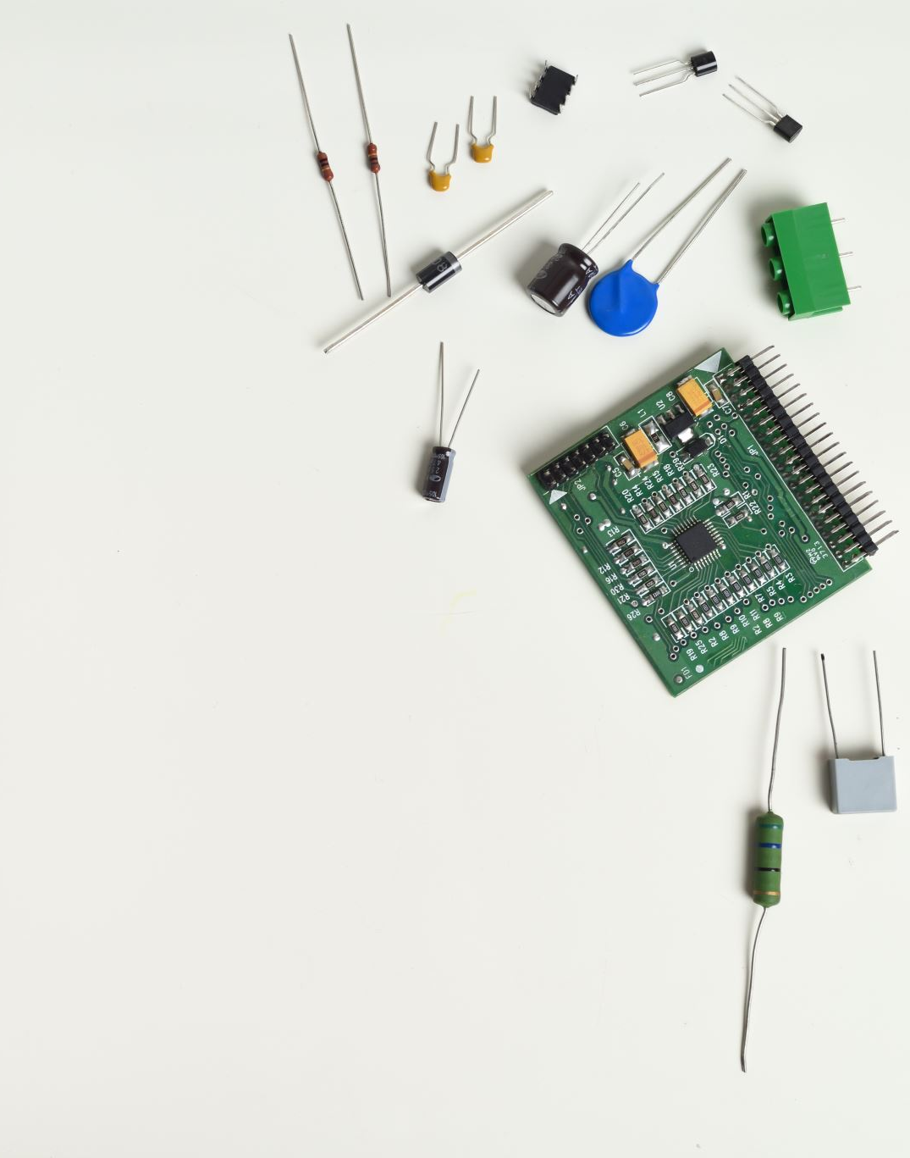
Contents
Introduction of Arduino.
Introduction of IR sensor.
Interfacing and connections of IR sensor with Arduino
Coding steps
Output
Hardware circuit
References.

Slide 3
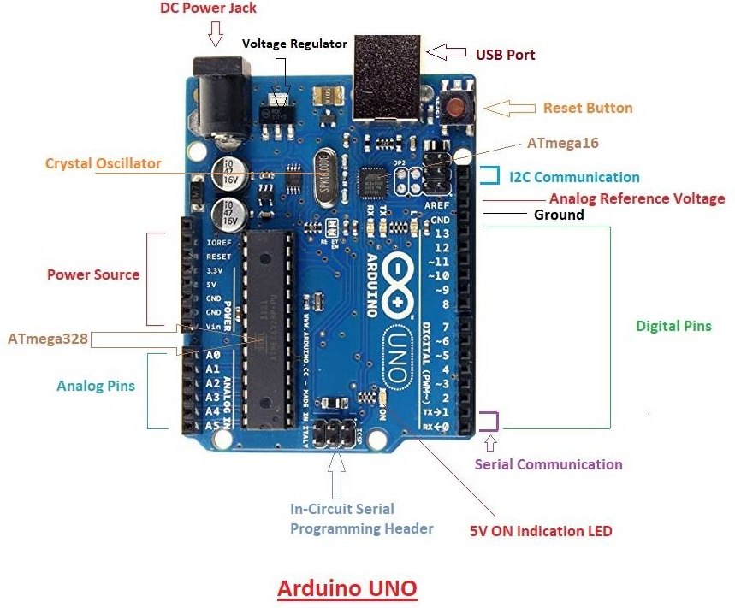
Introduction of Arduino
Arduino Uno is AN open-source microcontroller platform based on Atmega 328.
It requires 6V-12V input power. With the power less than 6V it becomes unstable and power more than 12V it cause heating issues and Chances of damaging the board are high.
6 pins are used for power source.
6 analog pins A0-A5.
14 input and output pins out of which 6pins can be Used for PWD output.
2 dedicated pins for I2C protocol.
DC power jack and USB port is also present on board.

Slide 4
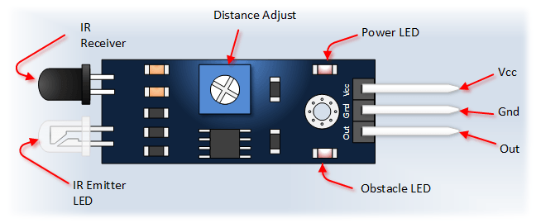
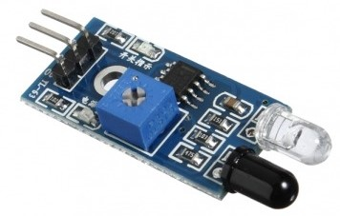
Introduction of Arduino
Introduction of IR sensor
IR sensor means infrared sensor, it have two major parts.
First part, IR LED or IR blaster to emit the infrared light towards
The object. Second part, it’s a light detector used to detect the
Reflected light from the obstacle.
There are 3 pins present for the connectivity of IR sensor
Which are VCC, ground and digital output.
The power requirement for IR sensor is 5V
In our project we are using 2 IR sensors.

Slide 5
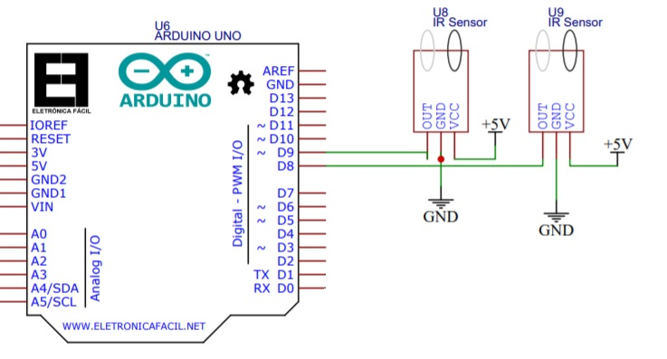
Interfacing and connections of IR sensor with Arduino
Two IR sensors are connected to the Arduino
Digital out of the sensors are connected to the digital pins 8 and 9 of the Arduino
Ground is connected to the ground
VCC is connected to the 5V

Slide 6
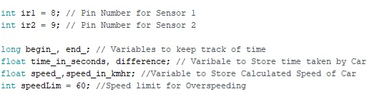
Coding steps
Initializing variable for both sensors ir1 and ir2
Initializing variables for keeping time track, time defference, speed.
Setting the maximum speed limit is to 60Km/Hr.

Slide 7
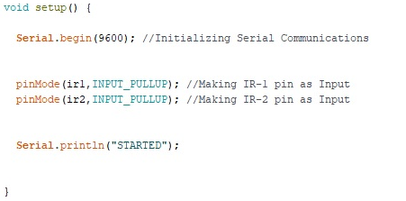
Coding steps
Setting up the serial monitor to baud rate 9600.
Setting IR1 and IR2 as input pins
Printing message “started”

Slide 8
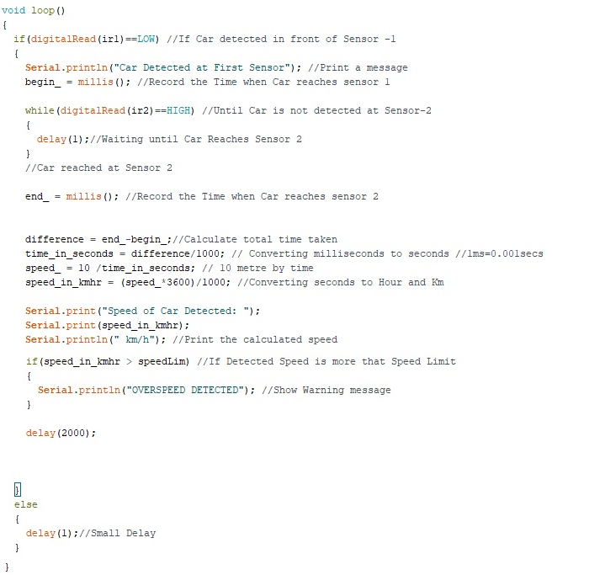
Coding steps
Final calculation of speed and time.
Checking speed is it higher than 60KM/HR or not.
Converting time from milisec. to hours.
Caculating speed using formula
Speed= distance/time
Display message “overspeed detection”

Slide 9
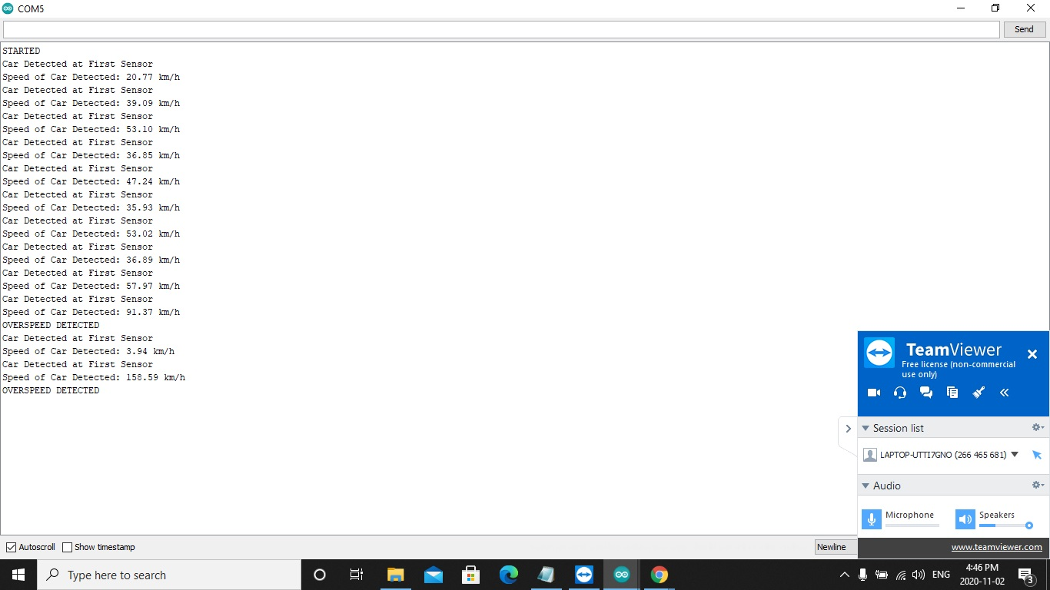
Output

Slide 10
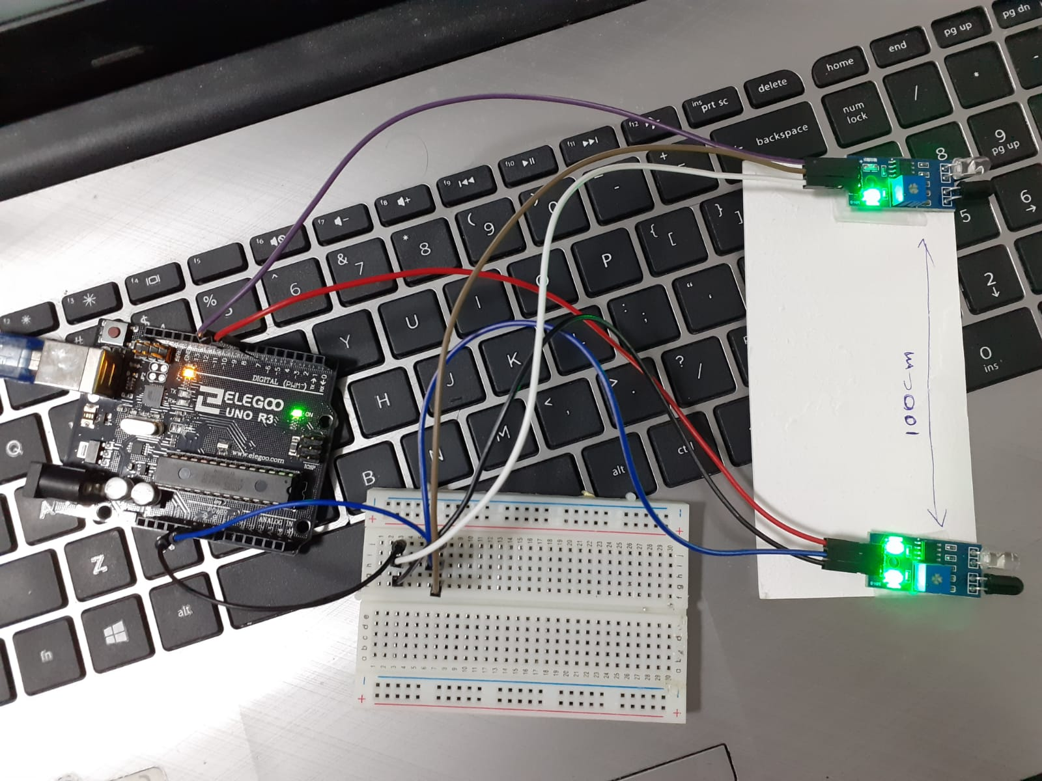
Hardware Circuit
Video of working circuit : https://www.youtube.com/watch?v=naHcDS3jQCE

Slide 11
REFERENCES
Nasir, S. Z. (2018, June 21). Introduction to Arduino UNO. Retrieved from https://www.theengineeringprojects.com/2018/06/introduction-to-arduino-uno.html
Arduino Uno. (2018, February 28). Retrieved from https://components101.com/microcontrollers/arduino-uno#:~:text=Arduino%20Uno%20is%20a%20microcontroller,on%208%2Dbit%20ATmega328P%20microcontroller.&text=Arduino%20Uno%20has%2014%20digital,header%20and%20a%20reset%20button
Shawn. (n.d). All about Proximity Sensors: Which type to use? Retrieved from https://www.seeedstudio.com/blog/2019/12/19/all-about-proximity-sensors-which-type-to-use/#:~:text=IR%20Proximity%20Sensor,a%20beam%20of%20infrared%20light.&text=Infrared%20proximity%20sensors%20consist%20of,optical%20spot%20on%20the%20PSD
IR Sensor Module. (2018, August 30). Retrieved from https://components101.com/sensors/ir-sensor-module

Slide 12
REFERENCES
Sharath. (n.d). IR Proximity Sensor with Arduino. Retrieved from https://www.factoryforward.com/ir-proximity-sensor-arduino/
Arduino Car Speed Detector. (2018, December 28). Retrieved from https://www.electronicshub.org/arduino-car-speed-detector/
Arduino with IR Sensor. (2019, September 23). Retrieved from https://create.arduino.cc/projecthub/Raushancpr/arduino-with-ir-sensor-1579b6
Arduino IDE Introduction. (2017, June 20). Retrieved from https://www.youtube.com/watch?v=nbD_V4QtNvY

